Slide 1
AICTE Project Submission
Artificial Intelligence
Student Details
Name: Pranjal Kumar
Skills Build Email Id : itselfpranjalkr@gmail.com
College Name: C.V. Raman Global University, Odisha
Internship Domain: Artificial Intelligence
Internship Start Date: 09/06/2023
Internship End Date: 24/07/2023

Slide 2

Problem Statement/Project Topic
Project Topic: Mental Fitness Tracker ML Model
Hello, everyone! We extend warm greetings to you all as we present the groundbreaking Mental Fitness Tracker ML Model. Today, we are thrilled to unveil our latest development, set to revolutionize the landscape of mental health care.
In a world where mental health is often neglected or burdened with stigma, our team recognizes the significance of addressing this vital aspect of overall well-being. Embracing the power of technology, our mission is to make a difference. With the Mental Fitness Tracker ML Model, we strive to empower individuals, mental health professionals, and organizations with a transformative tool to enhance mental wellness.

Slide 3

Agenda
Welcome to this presentation where we delve into the crucial aspects of the Mental Fitness Tracker ML Model. Our journey will cover a range of significant topics that shed light on the potential of this revolutionary project.
To begin, we'll offer an insightful overview of the model and its purpose, followed by a glimpse into the diverse audience it caters to. Discover how individuals, mental health professionals, and organizations can benefit immensely from its implementation.
Delving deeper, we'll unveil the unique solution and value proposition that the Mental Fitness Tracker ML Model brings to the table. Explore the myriad customization options available to tailor the model according to specific needs.
Throughout our session, we'll captivate your attention with real-world examples and compelling case studies, showcasing the profound impact this model can have on mental health and overall well-being. Witness firsthand how the cutting-edge realm of machine learning intertwines with the sphere of mental health, driving innovation and progress.

Slide 4

Project Overview
The Mental Fitness Tracker ML Model is designed to track and assess mental well-being using machine learning techniques.
The model analyzes various input features to predict mental fitness levels.
The project aims to provide individuals and mental health professionals with insights into mental well-being.

Slide 5

End User of the Project
The Mental Fitness Tracker ML Model targets individuals, mental health professionals, and organizations.
Individuals can track and monitor their mental fitness levels over time.
Mental health professionals can utilize the model to gain insights and support their assessment processes.
Organizations can use the model to evaluate the mental well-being of their employees and implement appropriate interventions.

Slide 6

Solution and Its Value Proposition
The Mental Fitness Tracker ML Model offers an automated and data-driven solution for mental fitness assessment.
The model provides accurate predictions of mental fitness based on input data.
Value Proposition:
Enables individuals to gain self-awareness and make informed decisions to improve mental well-being.
Assists mental health professionals in assessing and monitoring the mental fitness of their clients.
Helps organizations prioritize mental health initiatives and create supportive environments.

Slide 7

How Do I Customize the Project?
The Mental Fitness Tracker ML Model can be customized to accommodate specific requirements.
Users can modify the input features to include additional metrics relevant to their context.
The model allows flexibility in adapting to different populations and mental health frameworks.

Slide 8
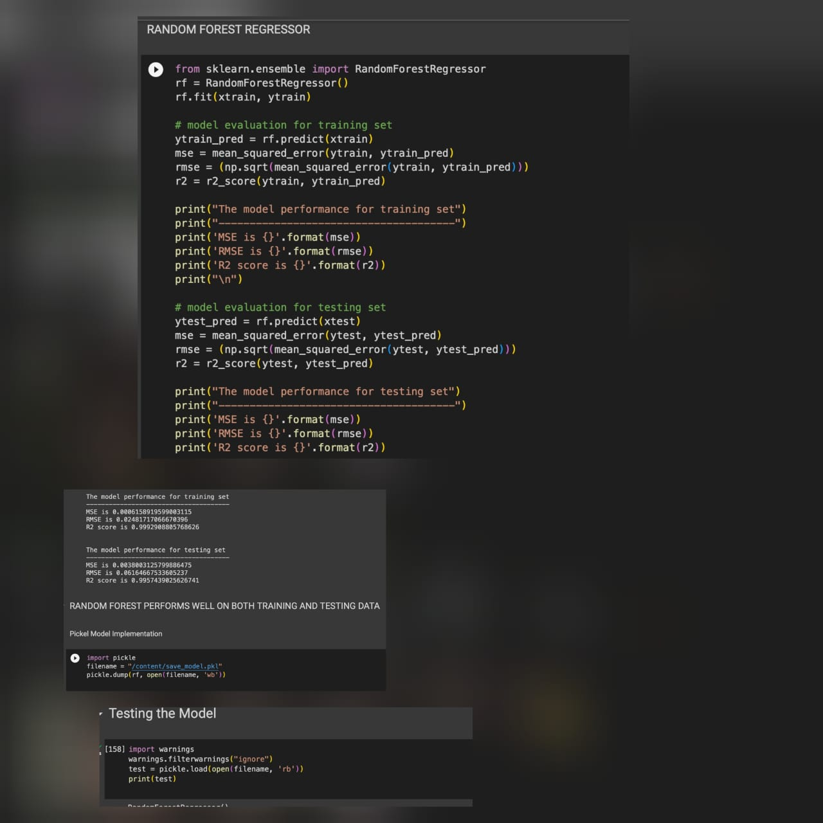
Modelling
Regression Model
The model utilizes the Random Forest Regression algorithm from the scikit-learn library.
Random Forest Regression provides accurate predictions and handles non-linear relationships between input features.
The model is trained using labeled data, allowing it to learn patterns and make informed predictions.

Slide 9
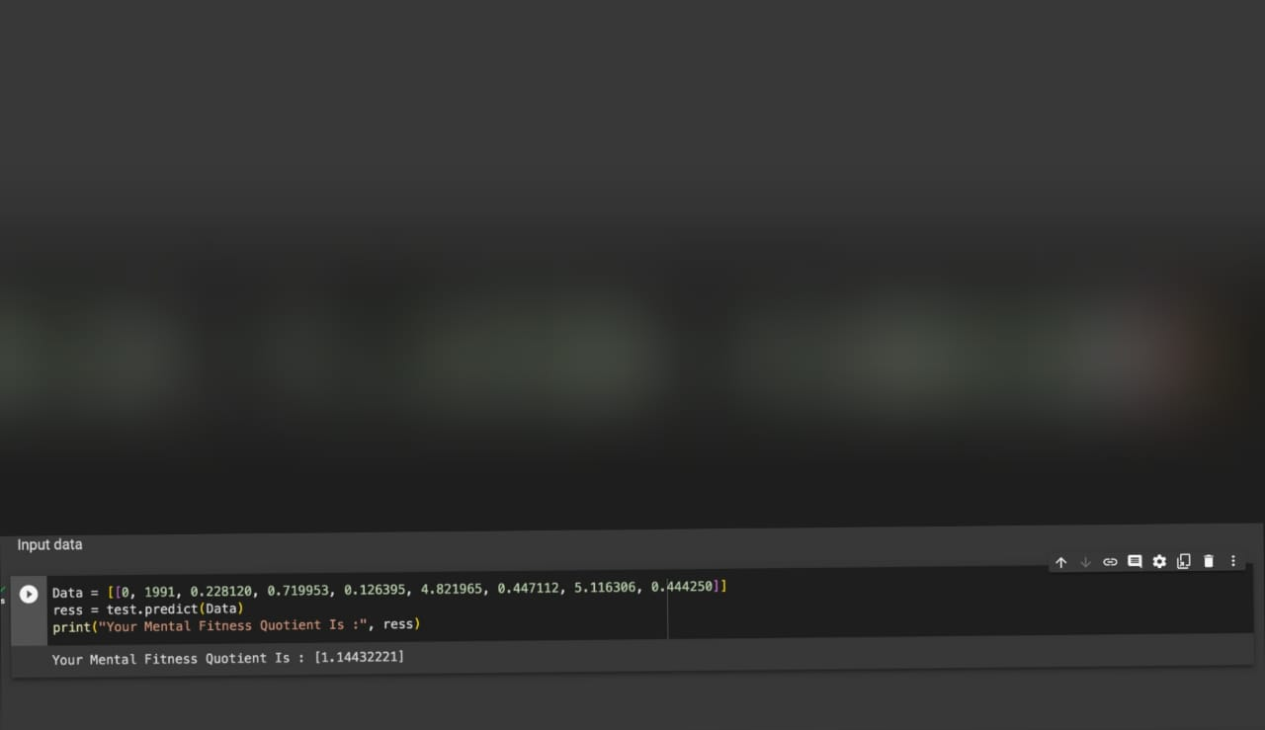
Results
The Mental Fitness Tracker ML Model produces valuable outcomes in mental fitness assessment.
Sample Input: ata = [[0, 1991, 0.228120, 0.719953, 0.126395, 4.821965, 0.447112, 5.116306, 0.444250]]
Predicted Mental Fitness Quotient: [predicted_result]
The model's performance is evaluated using metrics such as Mean Squared Error, Root Mean Squared Error, and R-Squared score.

Slide 10

Project Link
Access the Mental Fitness Tracker ML Model repository on GitHub:
https://github.com/pranjal-barnwal/mental-fitness-tracker
Explore the code, documentation, and the pickled model for further details.
Contributions, feedback, and collaborations are welcome.

Slide 11

THANK YOU!
Thank you for your attention and for joining us in this Mental Fitness Tracker Presentation. If you have any questions or would like to learn more about the project, please feel free to reach out.

